Slide 1

Welcome

Slide 2

About Me
This is Nahar. Iam Data entry expert. I am 19 Years old. I Live in Comilla. I Studied at Comilla govt. Victoria college at department of management. In My future I want to be a successful bussiness women

Slide 3
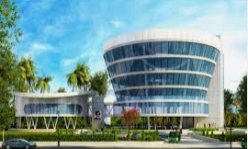
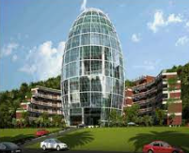
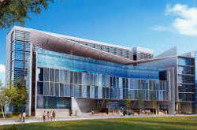
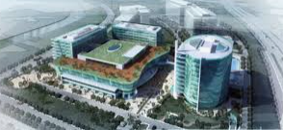
About IT Park
An IT park, short for Information Technology park, is a designated area where various technology-related businesses, often specializing in software development, IT services, research and development, and related fields, are clustered together. These parks are typically designed to provide an environment conducive to innovation, collaboration, and growth within the technology sector.
IT Park

Slide 4
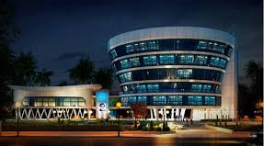
Comilla IT Park
If a Comilla IT park has been established, it would likely share many features common to IT parks globally, such as modern infrastructure, high-speed internet, business support services, and facilities for technology companies to collaborate and innovate.

Slide 5
IT park oppturnity
1
Job Creation:
2
Skills Development:
3
Attracting Investment
4
Fostering Innovation
5
Government Support and Incentives

Slide 6
Upcoming future IT Park
If there are plans for upcoming IT parks in Comilla or any region, here are some considerations and potential features:
Location Selection: Identifying an appropriate location with access to essential infrastructure, transportation networks, and amenities is crucial for the success of an IT park.
Infrastructure Development: The park would require the development of modern infrastructure, including office spaces, high-speed internet connectivity, power backup systems, and recreational facilities.
Government Support: Collaboration with government authorities to provide incentives, support, and streamlined regulatory processes can facilitate the establishment and growth of the IT park.
Industry Collaboration: Partnering with local universities, research institutions, and technology companies can foster innovation, skills development, and knowledge sharing within the park.
Sustainability Initiatives: Incorporating sustainable practices in the design and operation of the IT park, such as green building standards, renewable energy sources, and waste management systems, can enhance its environmental footprint.
Community Engagement: Engaging with the local community to understand their needs, concerns, and aspirations can help ensure that the IT park benefits all stakeholders and contributes positively to the region's socio-economic development.
Networking Opportunities: Providing spaces and platforms for networking, collaboration, and knowledge exchange among tenants and industry professionals can foster a vibrant ecosystem within the IT park.

Slide 7
Thank You

